Slide 1

Insights from Global Missing Migrants Dataset Analysis
Sk Zaid Hossain (BM24127)
Snigdhatanu Ray (BM24130)

Slide 2
Data Introduction
Theme of the data
This dataset offers a detailed account of missing migrants and their perilous journeys toward international destinations. It has been meticulously compiled by the Missing Migrants Project, an initiative led by the International Organization for Migration (IOM)
Source- Global Missing Migrants Dataset ,uploaded by Nidula Elgiriyewithana in Kaggle

Slide 3
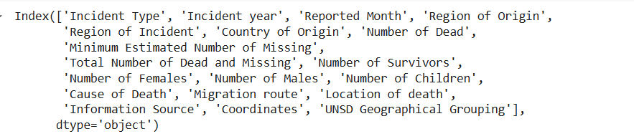
Data Overview
Time Period - 2014-2023
Dimension of the dataset : 13,020 Rows x 19 Columns
Key columns :
Incident Details -Incident type,Incident Year,Reported Month and Region of Origin
Demographics- Number of Dead , Minimum Estimated Number of Missing , Number of Survivors
Geographics Data - “Country of Origin”, “ Region of Incident”, “Migration Route”
Causes and Context - “Cause of Death “

Slide 4
What the data talks of ?
Incidents of any migration event is recorded .
The Incidents are recorded the stories of a migrant goes through-
Migrant fatalities
Common cause of death , including harsh conditions and violence.
The demographics of affected (male, female, children)
High risk routes
Location of origin and incident

Slide 5
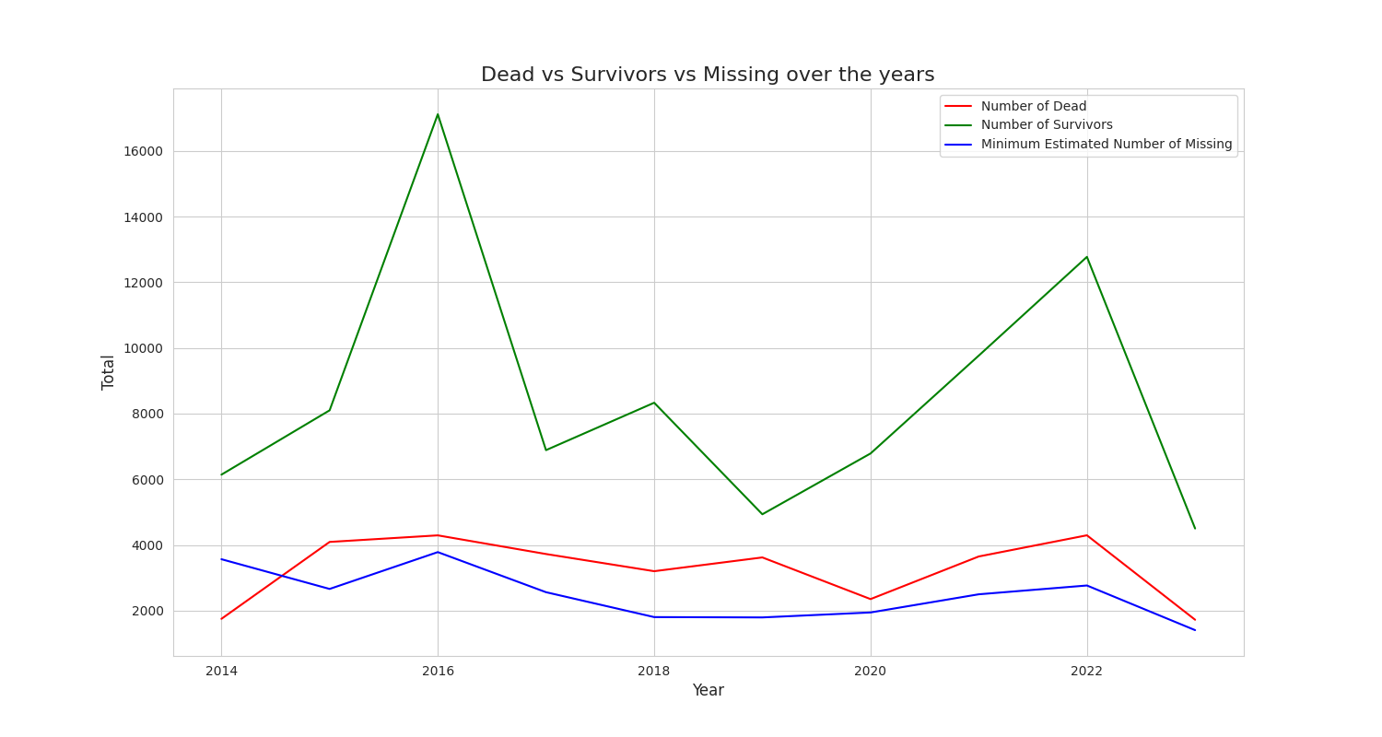
Dead Vs Survivors Vs Missing over the years
2016 - Peak in survivors
Decreasing trend in Missing people over the year
The number of survivors fluctuates over the years, suggesting variations in rescue efforts and the overall safety of migration routes.
Survivors consistently outnumber fatalities and missing individuals over the years, reflecting both the risks and resilience in migration journeys

Slide 6
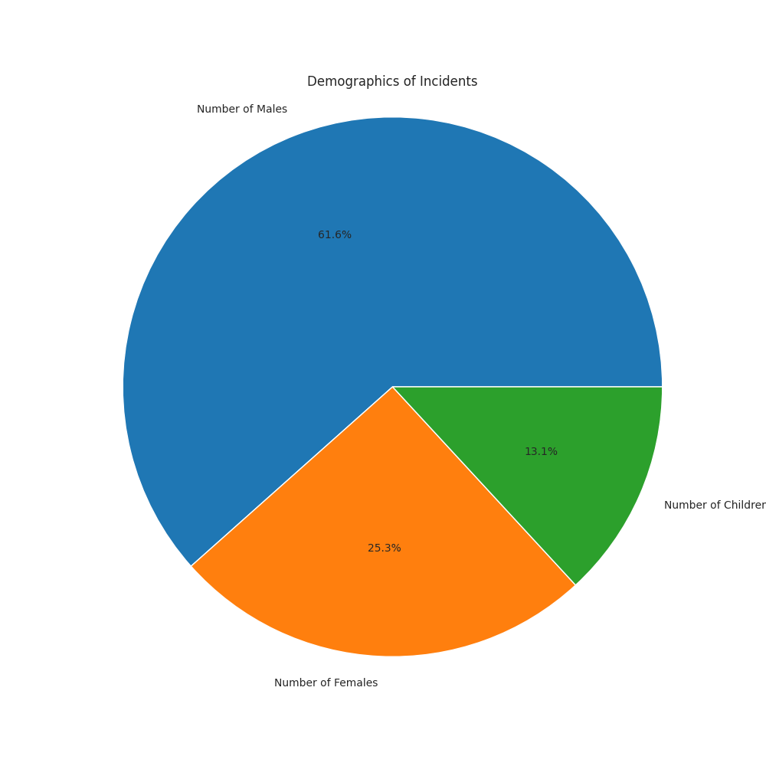
Gender distribution
The largest segment of the pie chart is dedicated to males, accounting for 61.6% of the incidents.
Females and childrens are considerably vulnerable to the prey of migrant .

Slide 7
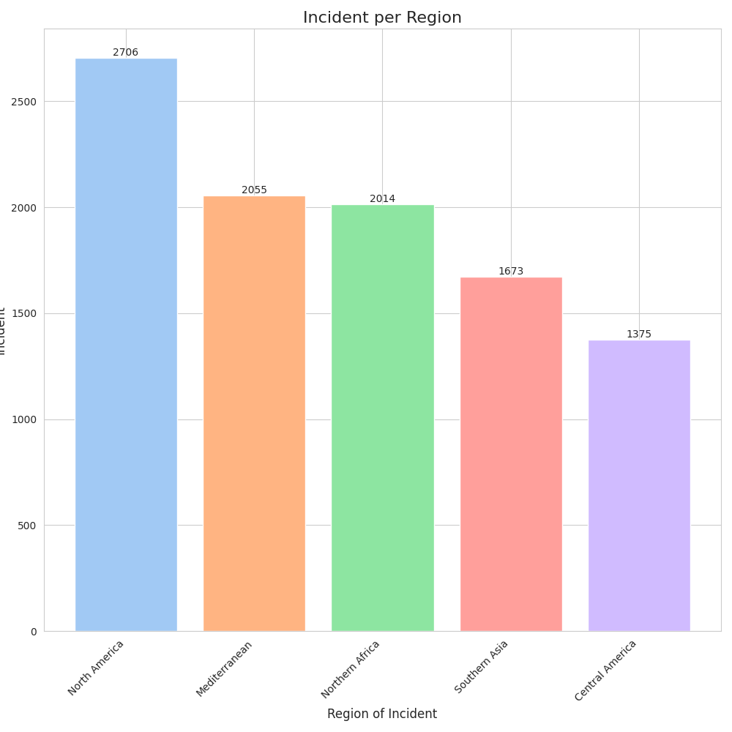
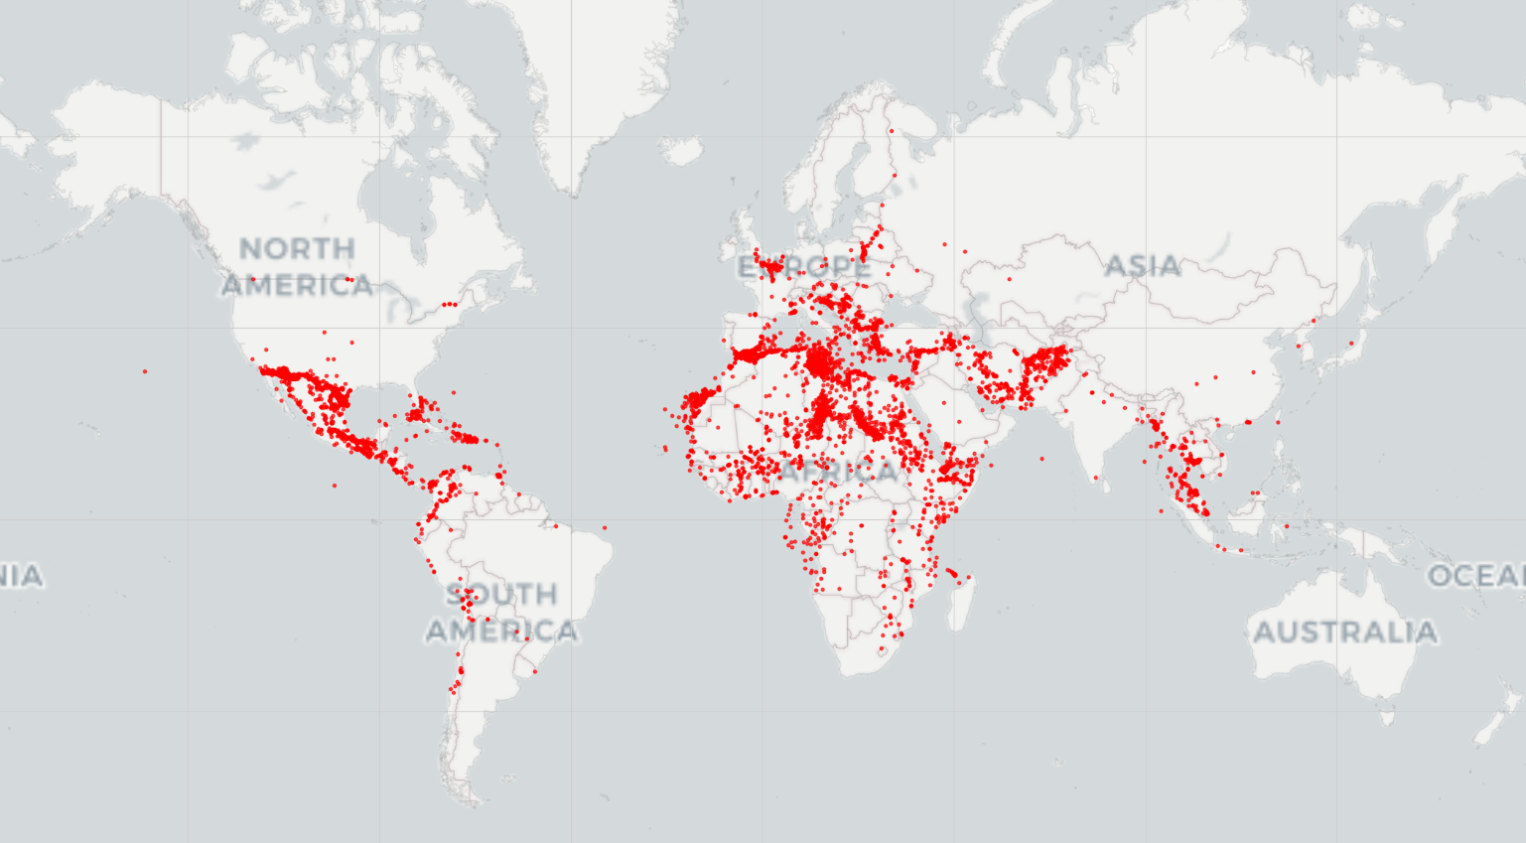
Region wise migration incidents
North America has highest incident rate , followed by Mediterranean region.

Slide 8
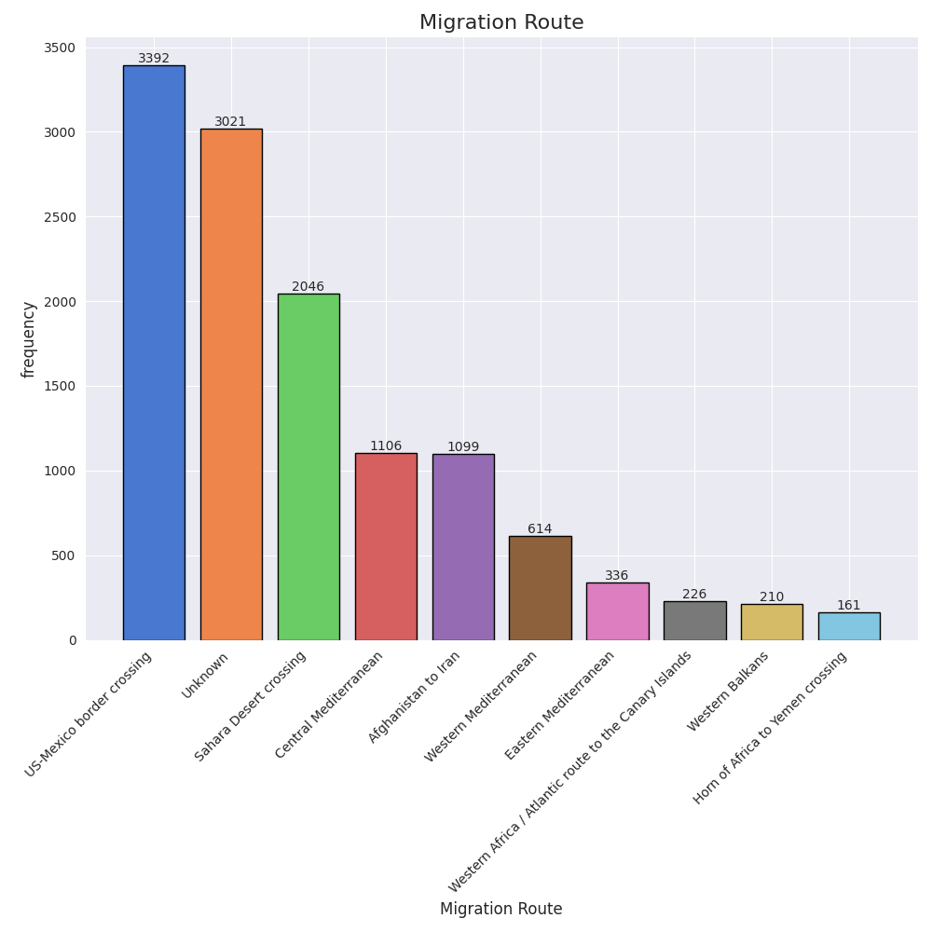
Migration Routes taken
The US-Mexico border crossing is the most frequently used migration route.
The second highest routes are “unknown” signifies the lack of proper data recording methods

Slide 9
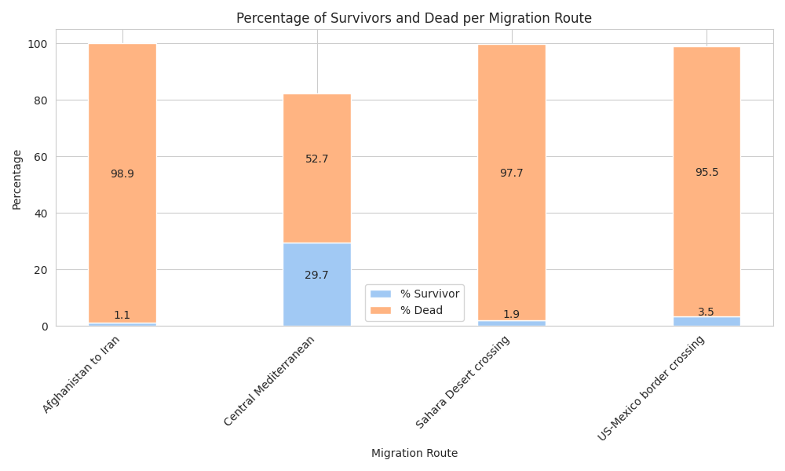
Routes analysis
Most taken route ,US- Mexico border has a death percentage of 95 %
The survival percentage for Central Mediterranean is more than others.
The death percentage is higher when the Afghanistan to Iran route is taken.
Top 5 routes taken by migrants

Slide 10
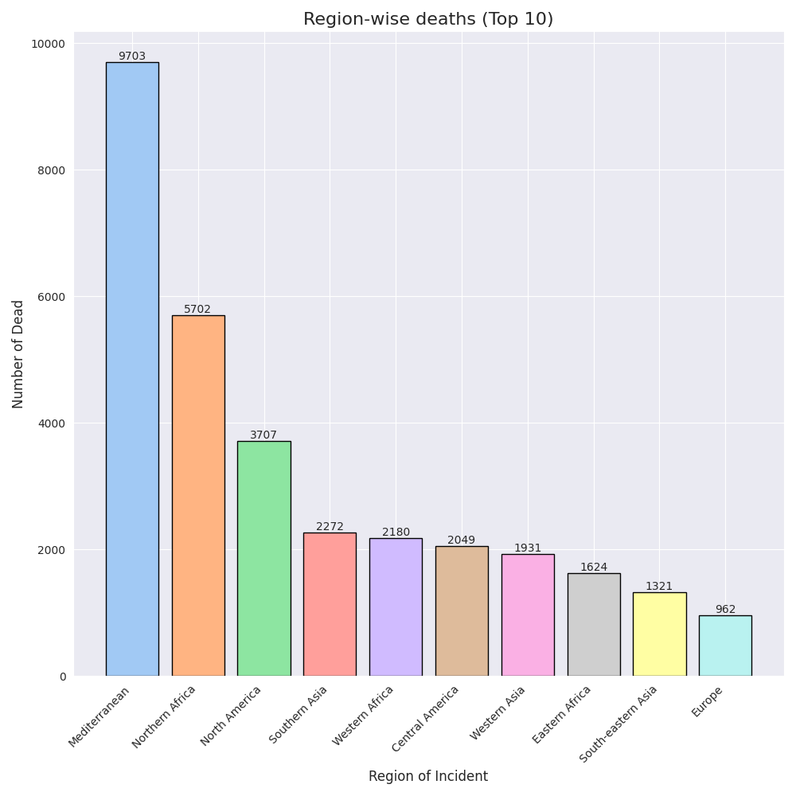
Region wise Death
Mediterranean region has higher deaths than other regions by a significant level.
Although North America has highest incidents recorded , the death numbers are proportionally less.
Europe has lowest death toll among all other regions.

Slide 11
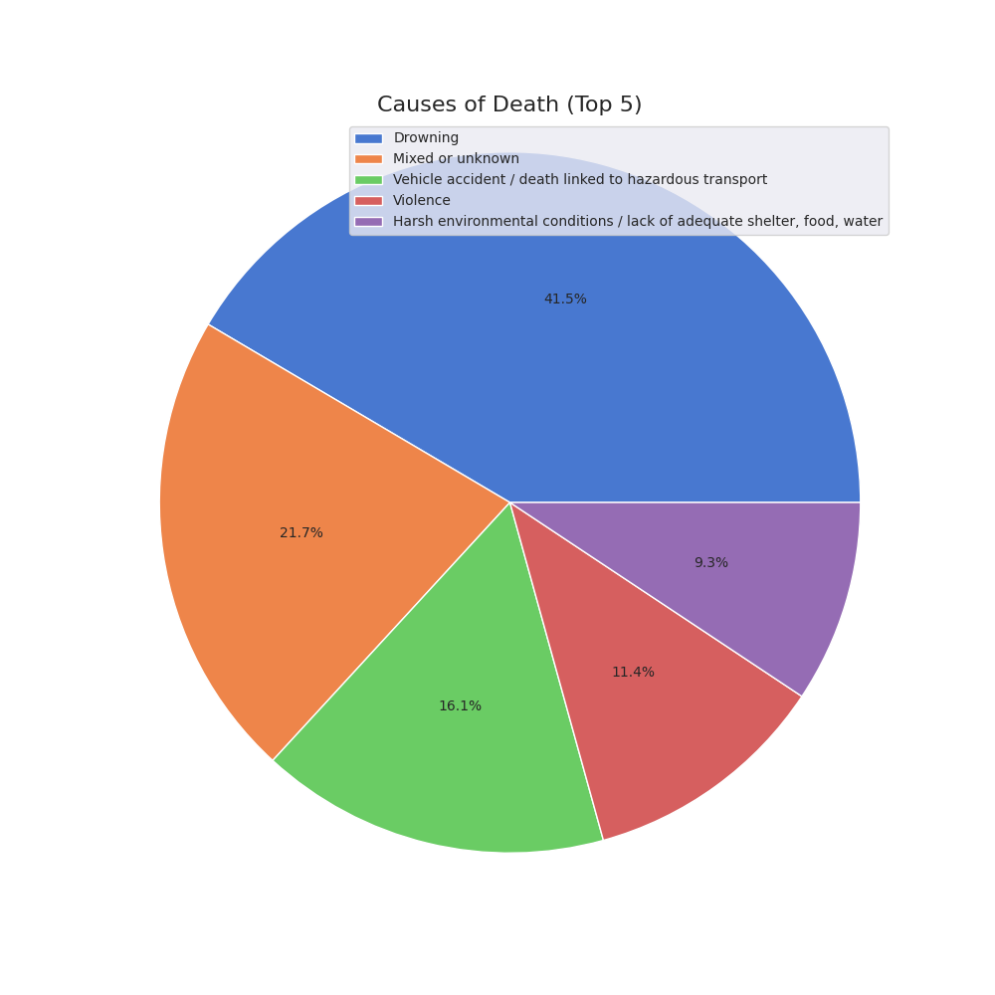
Causes of Death
Drowning is the leading cause of death highlighting the significant risk associated with migration routes, particularly those involving sea crossings.
Vehicle accidents and harsh environmental conditions also pose significant risks
Violence and mixed or unknown causes are less frequent but still contribute to a significant number of deaths

Slide 12
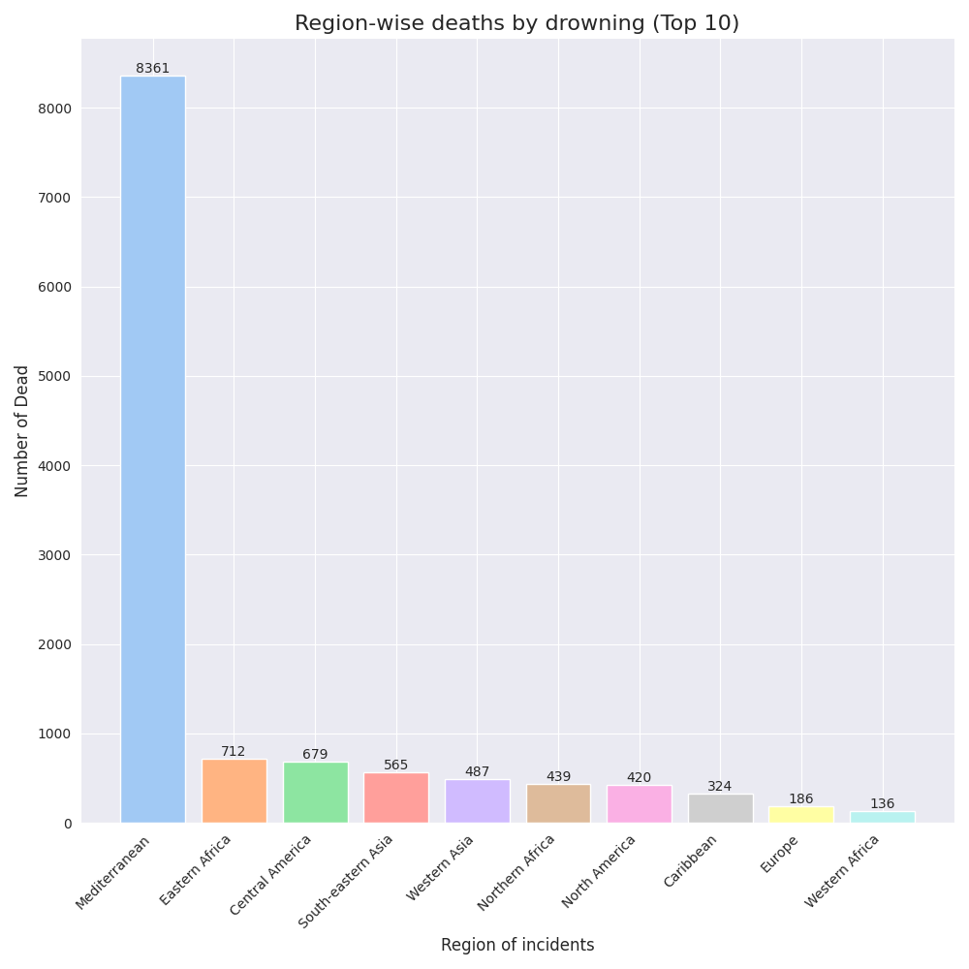
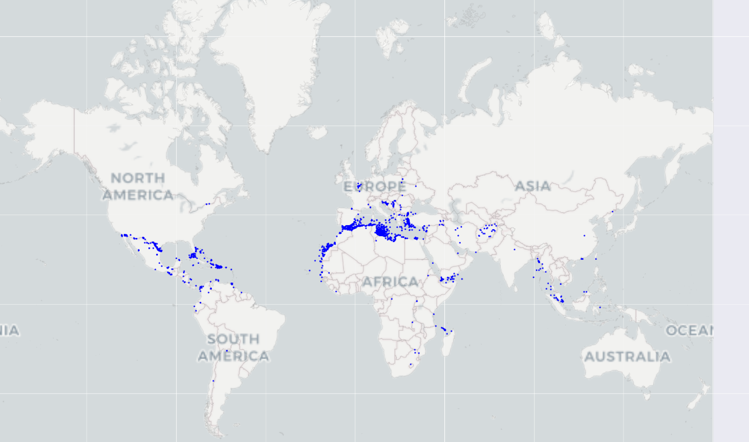
Analysis of death by drowning
Out of 9703 deaths in Mediterranean region , 8361 deaths are due to drowning i.e 86 % .

Slide 13
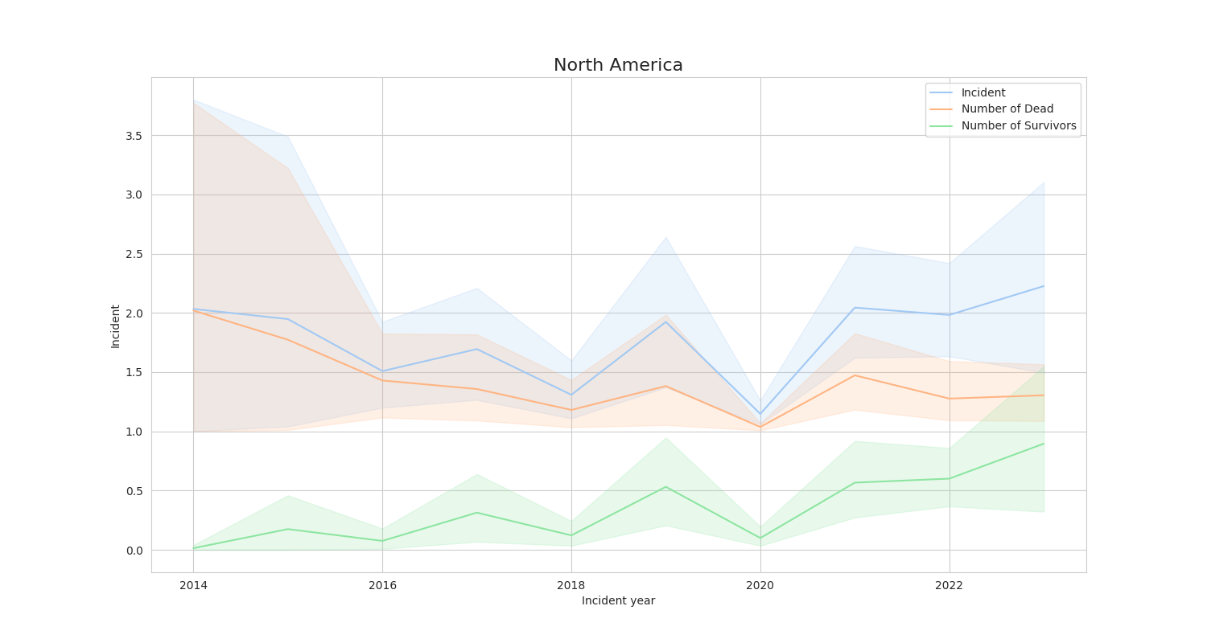
North America analysis
North America the hotspot of migration crisis.
Migration incidents in North America shows a fluctuating trend
With a steady increase in survivors compared to fatalities over the years.
Recent years have seen better rescue mission of migration

Slide 14
Conclusion
Steady decline of missing migrants - Better migration policies in developed countries.
Most incidents involve males.
North America sees high migration inflow - From South American region
"Unknown" incidents are challenges
Safest route - Central Mediterranean route
Deadliest route - Afghanistan - Iran route
Leading cause of death is drowning .
Most incidents of drowning - Mediterranean region (sea) due to migration from Africa to Europe .

Slide 15
Conclusion explanation
Though the incidents are on rise , the surviving stories are increasing while missing numbers are on steady decline.
Majority of the incidents involve male individuals. Although females are childrens are vulnerable to the migration incidents.
North America has has a significant migration inflow from South American region as it can be assessed from the frequency of US- Mexico border.
The high number of "Unknown" incidents suggests challenges in tracking migration pattern . It causes problem in analysing the reality of the crisis.
The safest route for migrants being Central Mediterranean while the deadliest being Afghanistan - Iran route.
The most frequently taken route is US- Mexico route shows the significant flow of migrants between these two countries.
Mediterranean Region suffers from highest number of deaths due to migration.
Drowning is the leading cause of deaths.
Mediterranean Region has the highest cause of deaths due to drowning. The migration attempts are taken from Africa to Europe as a result, Mediterranean sea becomes death zone.

Slide 16
Recommended approach to migration crisis
Prioritize High -fatality routes
Focus on deadliest route - High fatality rate ( Afghanistan - Iran route , Sahara route )
Regional Resource Allocation- Regions with highest death and incident rates .
Centralize Missing Migrants Data:
Enhance data systems for tracking missing persons across regions and borders.
Correlate Migration Data with External Factors
Investigate how economic instability or climate events drive migration patterns.
Focus on Underreported Areas
Fill data gaps -Identify regions or routes with inconsistent data and improve reporting

